Slide 1
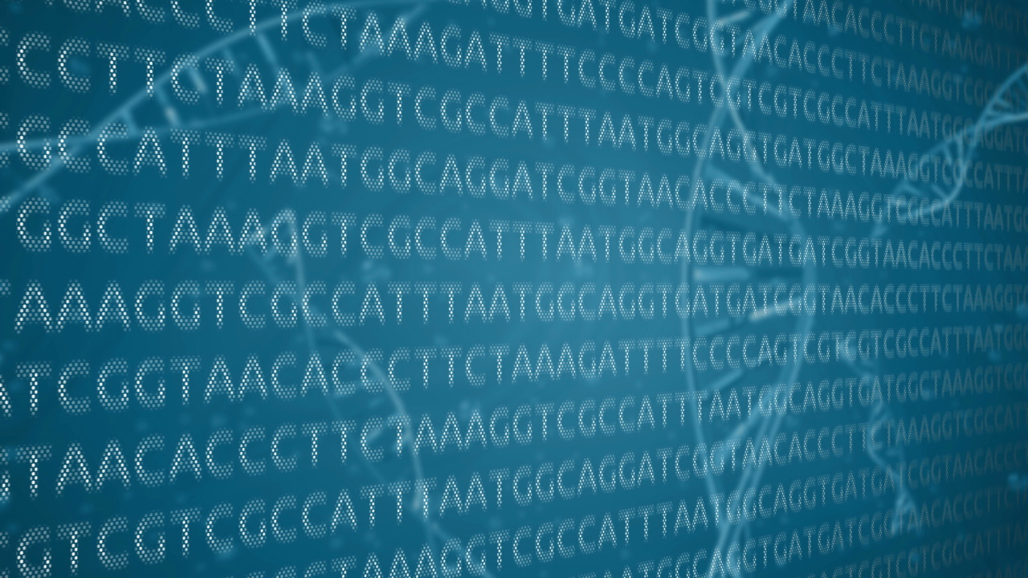
Paul Kadota
5/23/17

Slide 2
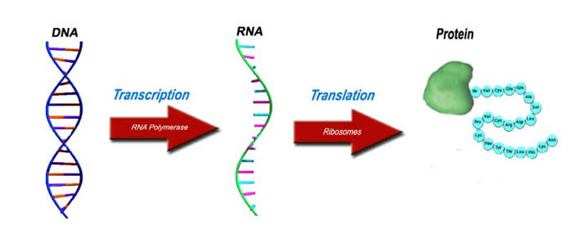
Central Dogma to Molecular Biology
The underlying paradigm for transfer of biological information starts with DNA, which is transcribed to RNA and translated to chains of amino acids as proteins.
http://www.lhsc.on.ca/Patients_Families_Visitors/Genetics/Inherited_Metabolic/Mitochondria/DiseasesattheMolecularLevel.htm

Slide 3
Challenges for genetic analysis
Despite the simplistic overview of DNA encoding for proteins, the sheer size and complexity of genetic analysis contains many hurdles to the human genome.
The human genome contains 3 billion nucleotides that provide instructions for ~22,000 genes.
Creating bioinformatic tools to automate this process of genetic analysis is key.

Slide 4
Python as the Ideal Tool for Genetic Analysis
Python provides a high-level programming environment to probe and analyze genetic information.
The quantized and simplistic nature of the nucleotides can be called as ‘string-like’ objects in the Python environment
The true strength of Python as a tool for genetic analysis is the abundant libraries of community-developed and supported tools in the realm bioinformatics.

Slide 5
Overview of Genetic Analysis in Python
Transcription
Biopython – Import FASTA & Transcribe DNA to RNA
Translation
Define function for nucleotide to amino acid translation
Sequence Alignment (DNA)
Sequence alignment between reference and query sequences
Sequence Alignment (aa)
Biopython (Pairwise2) – Sequence alignment between human and mouse

Slide 6
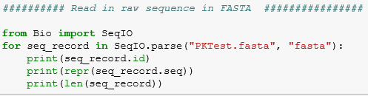
Biopython
Biopython (‘bio’) is an open-source library of tools that aid in computational biology.
My first use of ‘bio’ was to parse the DNA sequence from FASTA files for downstream analysis.

Slide 7
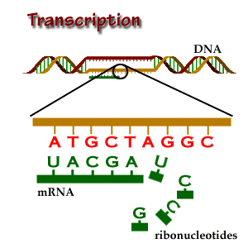
Transcription (1)
DNA (coding & template) is copied into RNA (mRNA).
Biologically, the reverse 3’5’ template strand is copied into RNA
In silico, we can just use the 5’3’ coding sequence and switch the thymine to uracil (T ->U)
http://www.brooklyn.cuny.edu/bc/ahp/BioInfo/TT/TscriptD.html

Slide 8
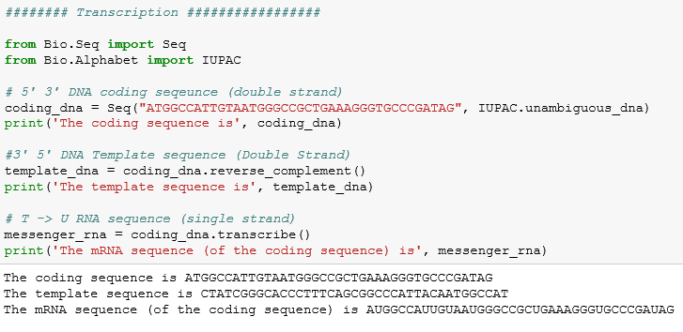
Transcription (2)
Biopython – Bio.Seq & Bio.Alphabet transcribe DNA sequences
http://www.brooklyn.cuny.edu/bc/ahp/BioInfo/TT/TscriptD.html

Slide 9
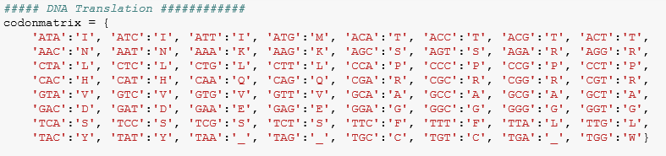
Translation (1)
Translation of DNA to amino acid sequences requires a matrix of codons (nucleotide triplet) to their respective amino acids.
The ‘stop’ codons, ‘TAA’, ‘TAG’, and ‘TGA’ signal the termination of translation for a particular protein

Slide 10
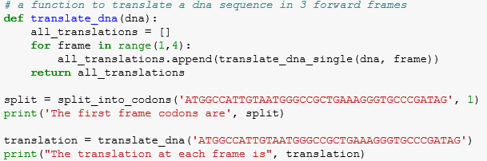
Translation (2)
There are four Python functions to:
1.) Translate the codons
2.) Split the input sequence into the codons
3.) Translate the DNA into each possible reading frame
4.) Translate the DNA into all 3 reading frames (pictured below)

Slide 11
Sequence Alignment (1)
In bioinformatics, matching a query sequence to a previously known reference sequence can help identify regions of DNA
The following series of Py functions are based on a method of matching the greatest length of the query sequence to the reference using this scoring matrix.
Scoring Matrix | A | T | G | C
A | 1 | -1 | -1 | -1
T | -1 | 1 | -1 | -1
G | -1 | -1 | 1 | -1
C | -1 | -1 | -1 | 1

Slide 12
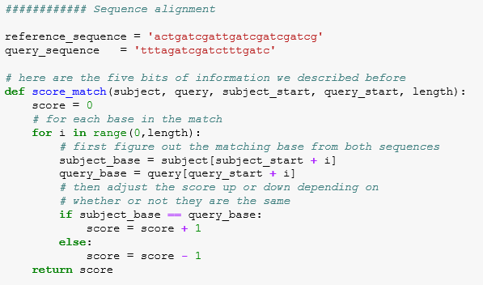
Sequence Alignment (2)
In this selective function, a priori knowledge of a ‘good’ matching score searches individual query-reference one at a time.

Slide 13
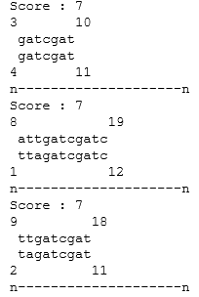
Sequence Alignment (3)
In this ‘brute force’ Python function, each possible sequence is matched to the reference and given an aggregate score. The top scores are listed:

Slide 14
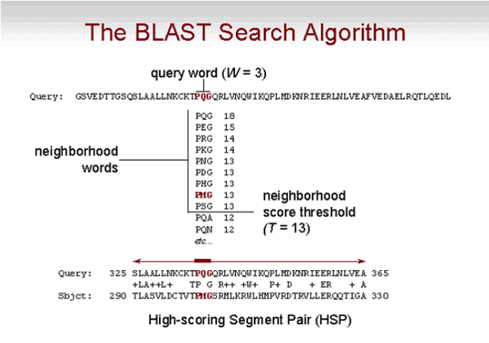
Sequence Alignment (4 - BLAST)
Unlike this ‘brute-force’ method, more sophisticated programs, such as BLAST (Basic Local Alignment Search Tool), are far more efficient at sequence alignment.
Instead running every possible alignment, BLAST identifies small regions of high similarity and subsequently extends in both directions to find high-quality and long matched sequences.
web.uconn.edu

Slide 15
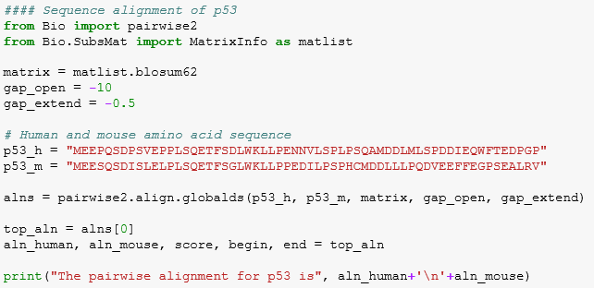
Gene Comparison Across Species
Comparing sequence alignment across species is a method to discover homologous proteins. This Biopython package compares a human and mouse p53 oncogene

Slide 16
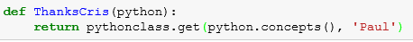
Conclusions
The use of Python is an extremely efficient and comprehensive method for genetic analysis.
From basic data entry files, Python and its extensive libraries can create in-depth genetic analysis.
Entire pipelines of transcription, translation, alignment and beyond can be created and run with a few Advanced Concepts in Computer Programming

